Slide 1
Graphs
CSE 2213 – Discrete Mathematics
Course teacher: Minhajul Bashir

Slide 2
Some special simple graphs

Slide 3
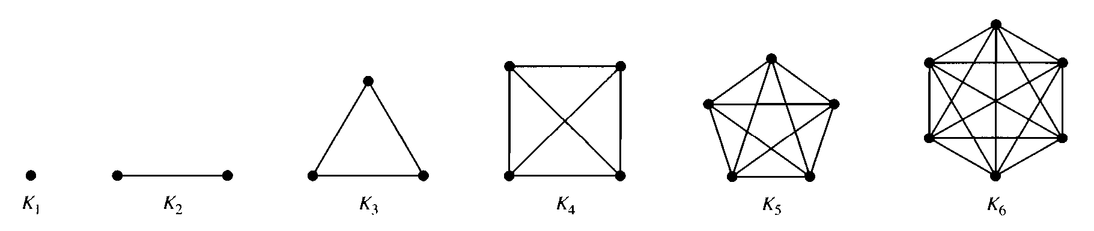
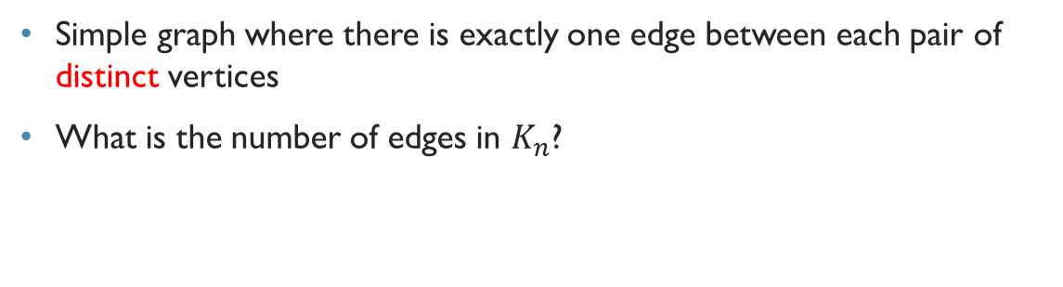
Complete graph
Simple graph where there is exactly one edge between each pair of distinct vertices
What is the number of edges in $K_{n}$?

Slide 4
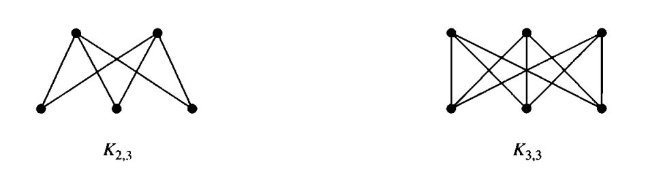
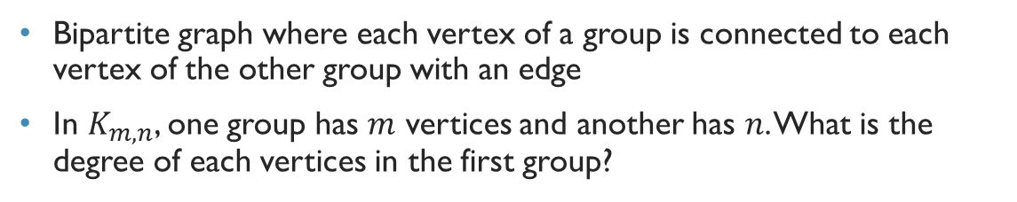
Complete bipartite graph
Bipartite graph where each vertex of a group is connected to each vertex of the other group with an edge
In $K_{m,n}$, one group has $m$ vertices and another has $n$. What is the degree of each vertices in the first group?

Slide 5
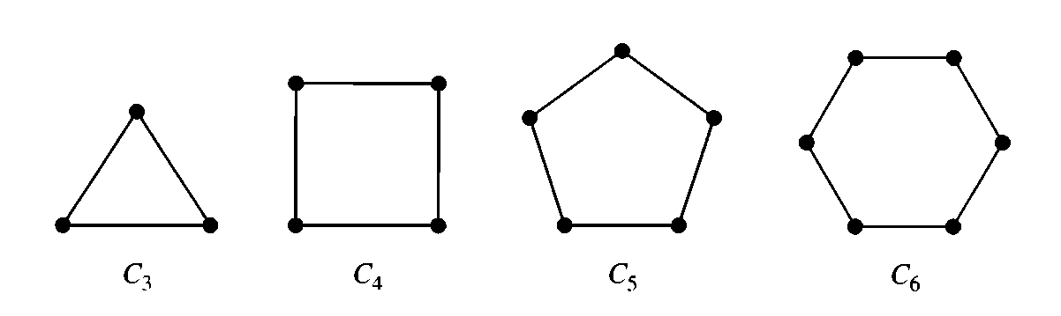
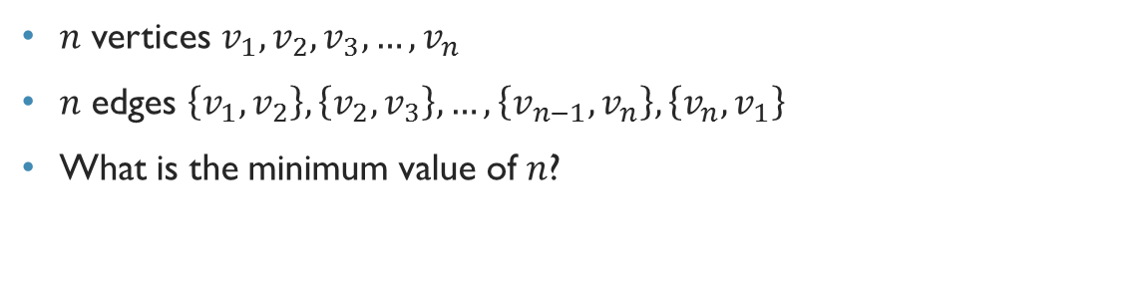
Cycles
$n$ vertices $v_{1},v_{2},v_{3},…,v_{n}$
$n$ edges $\left\{v_{1},v_{2}\right\},\left\{v_{2},v_{3}\right\},…,\left\{v_{n−1},v_{n}\right\},\left\{v_{n},v_{1}\right\}$
What is the minimum value of $n$?

Slide 6
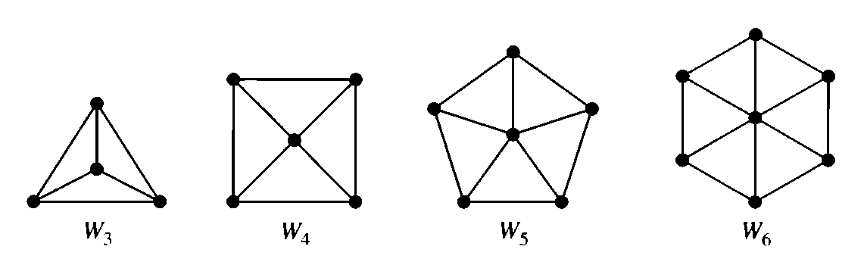
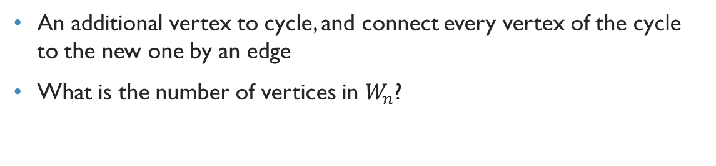
Wheels
An additional vertex to cycle, and connect every vertex of the cycle to the new one by an edge
What is the number of vertices in $W_{n}$?

Slide 7
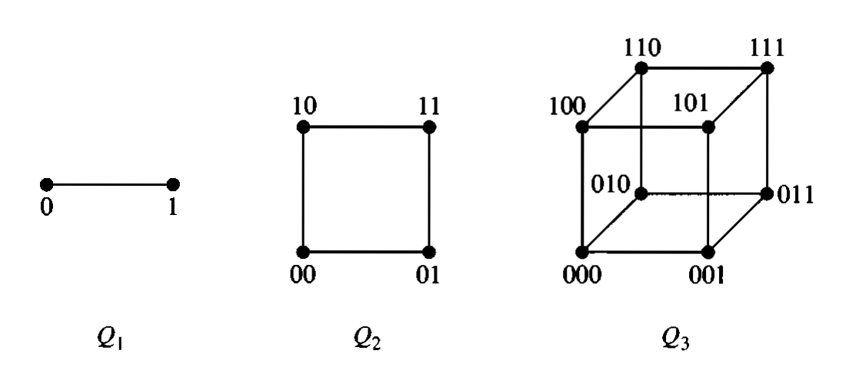
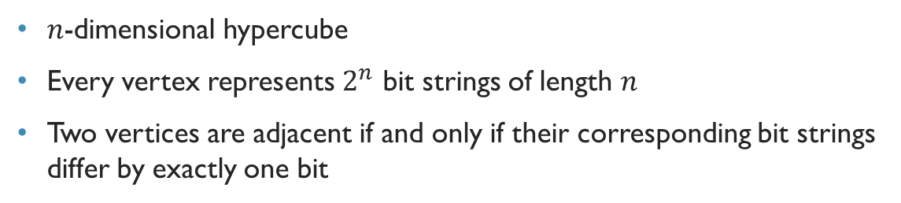

$n$-cubes
$n$-dimensional hypercube
Every vertex represents $2^{n}$ bit strings of length $n$
Two vertices are adjacent if and only if their corresponding bit strings differ by exactly one bit

Slide 8
Graph representation

Slide 9
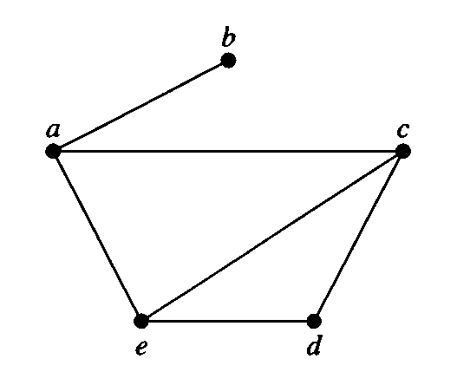

Adjacency list
Vertex Adjacent vertices
$a$ $b,c,e$
$b$ $a$
$c$ $a,d,e$
$d$ $c,e$
$e$ $a,c,d$

Slide 10
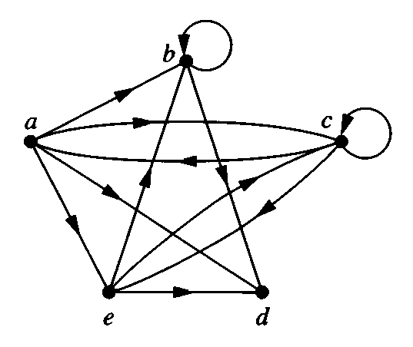

Adjacency list
Initial Terminal vertices
$a$ $b,c,d,e$
$b$ $b,d$
$c$ $a,c,e$
$d$
$e$ $b,c,d$

Slide 11
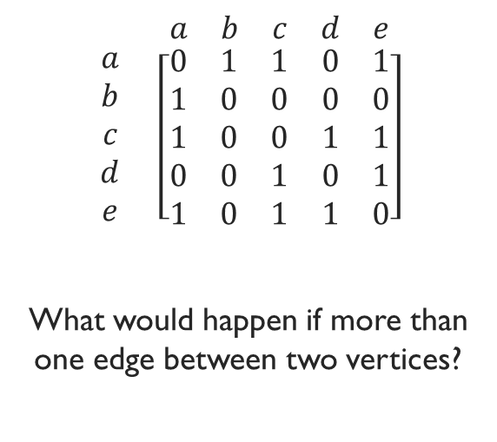
Adjacency matrix
$$\begin{matrix} & \begin{matrix}a & b & c & d & e\end{matrix} \\ \begin{matrix}a \\ b \\ c \\ d \\ e\end{matrix} & \left[\begin{matrix}0 & 1 & 1 & 0 & 1 \\ 1 & 0 & 0 & 0 & 0 \\ 1 & 0 & 0 & 1 & 1 \\ 0 & 0 & 1 & 0 & 1 \\ 1 & 0 & 1 & 1 & 0\end{matrix}\right]\end{matrix}$$
What would happen if more than one edge between two vertices?

Slide 12
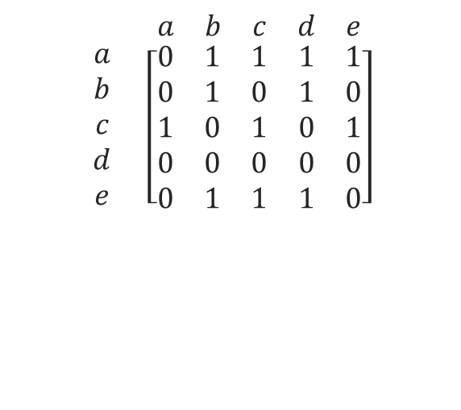
Adjacency matrix
$$\begin{matrix} & \begin{matrix}a & b & c & d & e\end{matrix} \\ \begin{matrix}a \\ b \\ c \\ d \\ e\end{matrix} & \left[\begin{matrix}0 & 1 & 1 & 1 & 1 \\ 0 & 1 & 0 & 1 & 0 \\ 1 & 0 & 1 & 0 & 1 \\ 0 & 0 & 0 & 0 & 0 \\ 0 & 1 & 1 & 1 & 0\end{matrix}\right]\end{matrix}$$

Slide 13
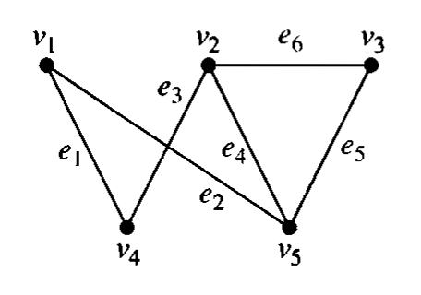
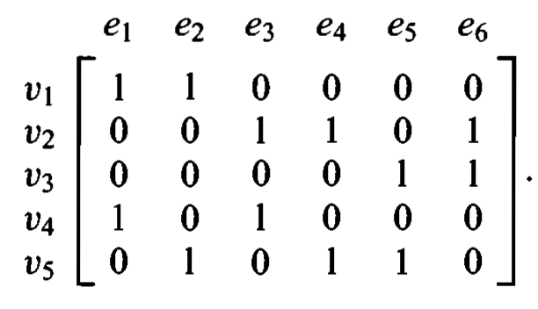
Incidence matrix

Slide 14
Miscellaneous examples

Slide 15
Exercise
Show that in a simple graph with at least two vertices, there must be at least two vertices with the same degree.

Slide 16
Show that in a simple graph with at least two vertices, there must be two vertices with the same degree.
Since the graph is simple, the possible values of the degrees is $0$ to $n−1$.
Note that a graph cannot have vertices of degrees both $0$ and $n−1$ (why?)
So the possible values of degrees is either $0$ to $n−2$, or $1$ to $n−1$
Since there are $n−1$ possible degrees for $n$ vertices, by pigeonhole principle, two of them must have the same degree

Slide 17
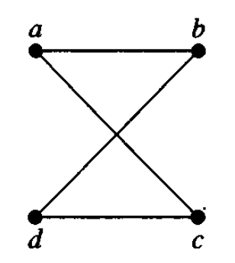
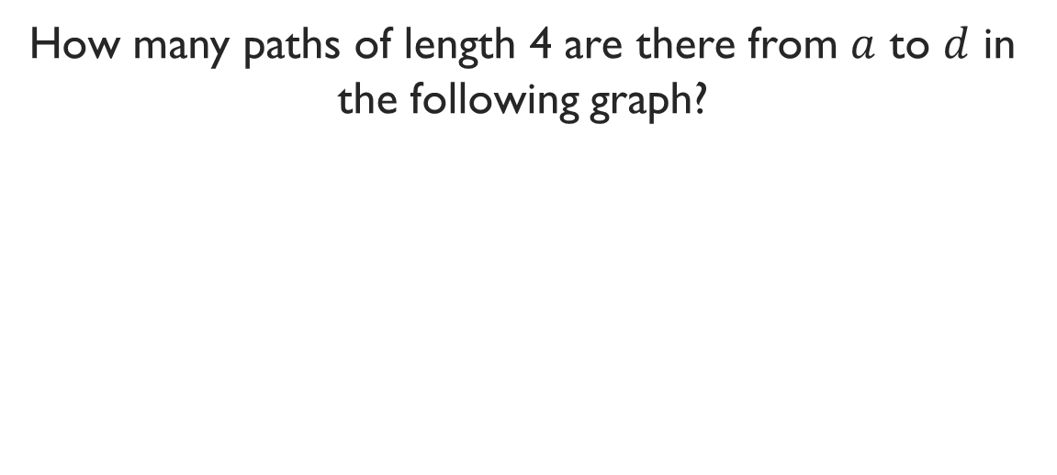
Exercise
How many paths of length 4 are there from $a$ to $d$ in the following graph?

Slide 18
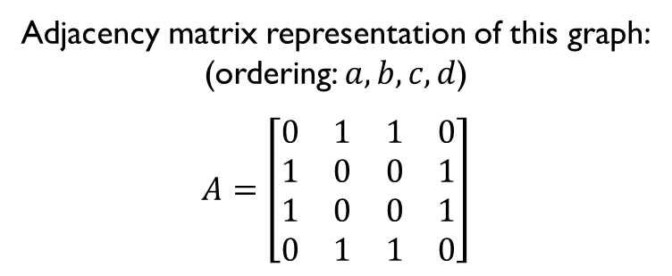
Adjacency matrix representation of this graph:
(ordering: $a,b,c,d$)
$$A=\left[\begin{matrix}0 & 1 & 1 & 0 \\ 1 & 0 & 0 & 1 \\ 1 & 0 & 0 & 1 \\ 0 & 1 & 1 & 0\end{matrix}\right]$$
The number of paths of length 4 from $a$ to $d$ is the (1, 4) entry of $A^{4}$.
$$A^{4}=\left[\begin{matrix}8 & 0 & 0 & 8 \\ 0 & 8 & 8 & 0 \\ 0 & 8 & 8 & 0 \\ 8 & 0 & 0 & 8\end{matrix}\right]$$
Therefore, there are 8 paths of length 4 from $a$ to $d$.

